Slide 1

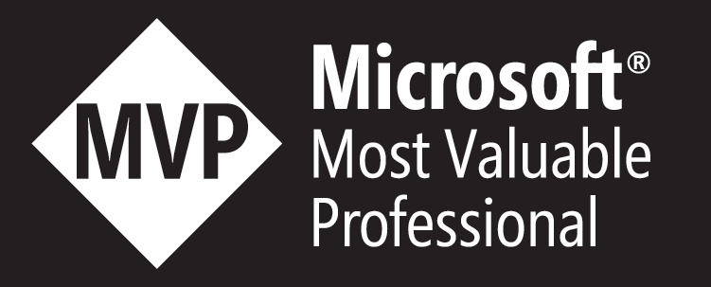
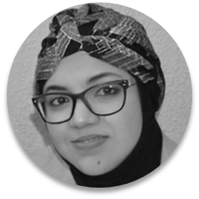
Developing Solutions for Microsoft Azure
Hamida REBAI – Microsoft MVP – Architect
@rebaihamida
didourebai@gmail.com
Notes:
Hello,
I hope you are fine; I am Hamida Rebai, I will present today a session about services Fabric and microservices.
You will learn today, the basics of service Fabric, local deployment and remotely in the cloud.

Slide 2
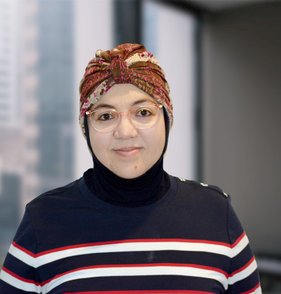




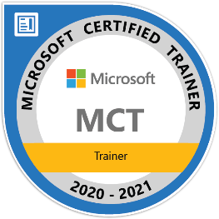
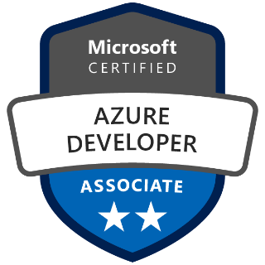
Microsoft MVP & MCT
Software Architect
Microsoft MVP in Developer Technologies
Member and Speaker at dotnetfoundation
Blogger and Technical writer
Rebai Hamida – Medium
Hamida Rebai Trabelsi | LinkedIn
Rebaï Hamida - YouTube
Microsoft MVP
Notes:
Who I’m?
I’m Microsoft MVP in developer technologies, a software architect, a membrer and a speaker in dotnetfoundation.
I’m also MCT and Azure certified.
You can follow me on medium blog, LinkedIn, youtube or twitter
If you have questions during the presentation, you can use the chat option on the right, I will answer you in the end of this session.

Slide 3
Agenda
Digital transformation and business needs
Azure App Service Web Apps
Prepare the environment
Demo: Create Azure App Service Web Apps
Azure Container Registry
Demo: Create an ACR with Azure Portal and Azure CLI
Azure Kubernetes Services
Demo: Create and deploy Kubernetes application
Azure Service Fabric
Demo: Create and Deploy a Service Fabric application to a cluster in Azure
Notes:
This is our agenda

Slide 4
Digital transformation and business needs
Faster delivery of features.
Hight availability of services
Prepare a qualitative model for estimating migration costs.
Perform the migration by limiting the impacts on the company
Notes:
In a changing market, one of the main challenges of maintaining the competitiveness of digital businesses remains IT agility. However, in their current state, computer systems are struggling to adapt to the latest technological developments such as mobility or the Internet of Things and to their new requirements. With a large number of interdependencies of services linked to the life cycle of an IT project, each modification of the source code of a classic monolithic application can destabilize it in maintenance.
For this reason, companies have resorted to more optimized, scalable architectures, ensuring continuous availability and less costly in terms of resource consumption and in particular oriented "microservices". This change is essential facing the aggressive competition, and in particular that of start-ups which are not yet congested by rigid infrastructure.

Slide 5
Patterns | Technologies
Microservices
Docker Containers
Autonomous
Bounded Context
Linux Containers
Docker Image
Nomad & addressable services
Isolated
Docker Host
API Gateway
Windows Containers
Docker Registry
Decoupled
Docker Hub
Events
Async. communication
Hyper-V Containers
Event Bus
Message Brokers
Azure Service Bus
Azure Container Registry
Service Discovery
Health Checks
Orchestrators
Transient Failures Handling
Resiliency
Azure Service Fabric
Stateful Services
Commands
Actors
Retries with Exponential Backoff
Azure Container Service
Domain-Driven Design
Circuit Breakers
RabbitMQ
CQRS simplified
Kubernetes
NServiceBus
Aggregates
Docker Swarm
MassTransit
Domain Entity
Domain Events
Mesos DC/OS
Brighter
Mediator
Polly
Notes:
This table summarizes the modern Patterns and technologies to be used for implementing solutions deployed to any cloud provider like containers. There are many models, most of which are linked or come from the domain-driven design.

Slide 6
Azure App Service Web Apps

Slide 7
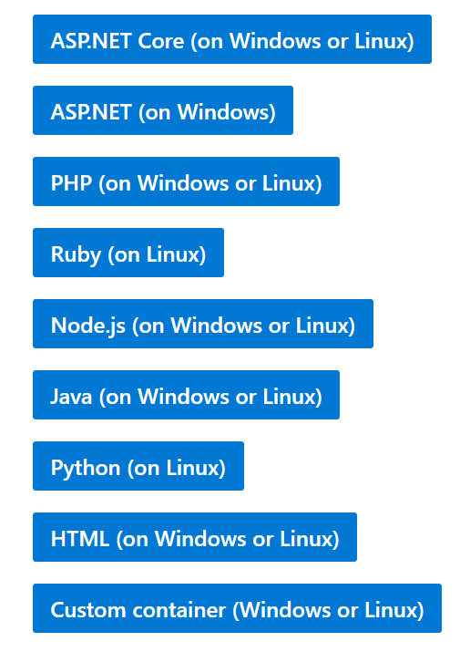
App Service
Service for hosting web applications, REST APIs, and mobile backends can be developed in many of languages.
Applications can execute and scale in a fully managed, sandbox environment
Notes:
Azure App Service not only adds the power of Microsoft Azure to your application, such as security, load balancing, autoscaling, and automated management. You can also take advantage of its DevOps capabilities, such as continuous deployment from VSTS, GitHub, Docker Hub, and other sources; and package management, staging environments, custom domain, and SSL certificates.
With App Service, you pay for the Azure compute resources that you use. The compute resources you use is determined by the App Service plan that you run your apps on.

Slide 8
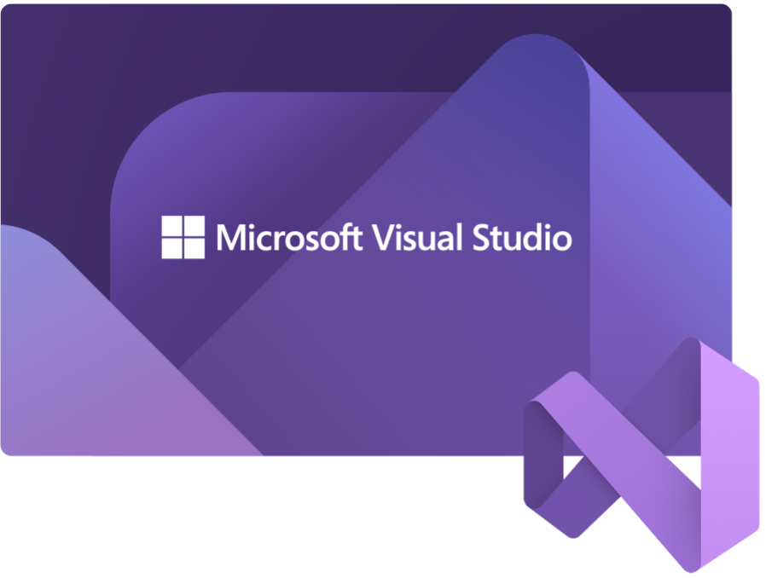

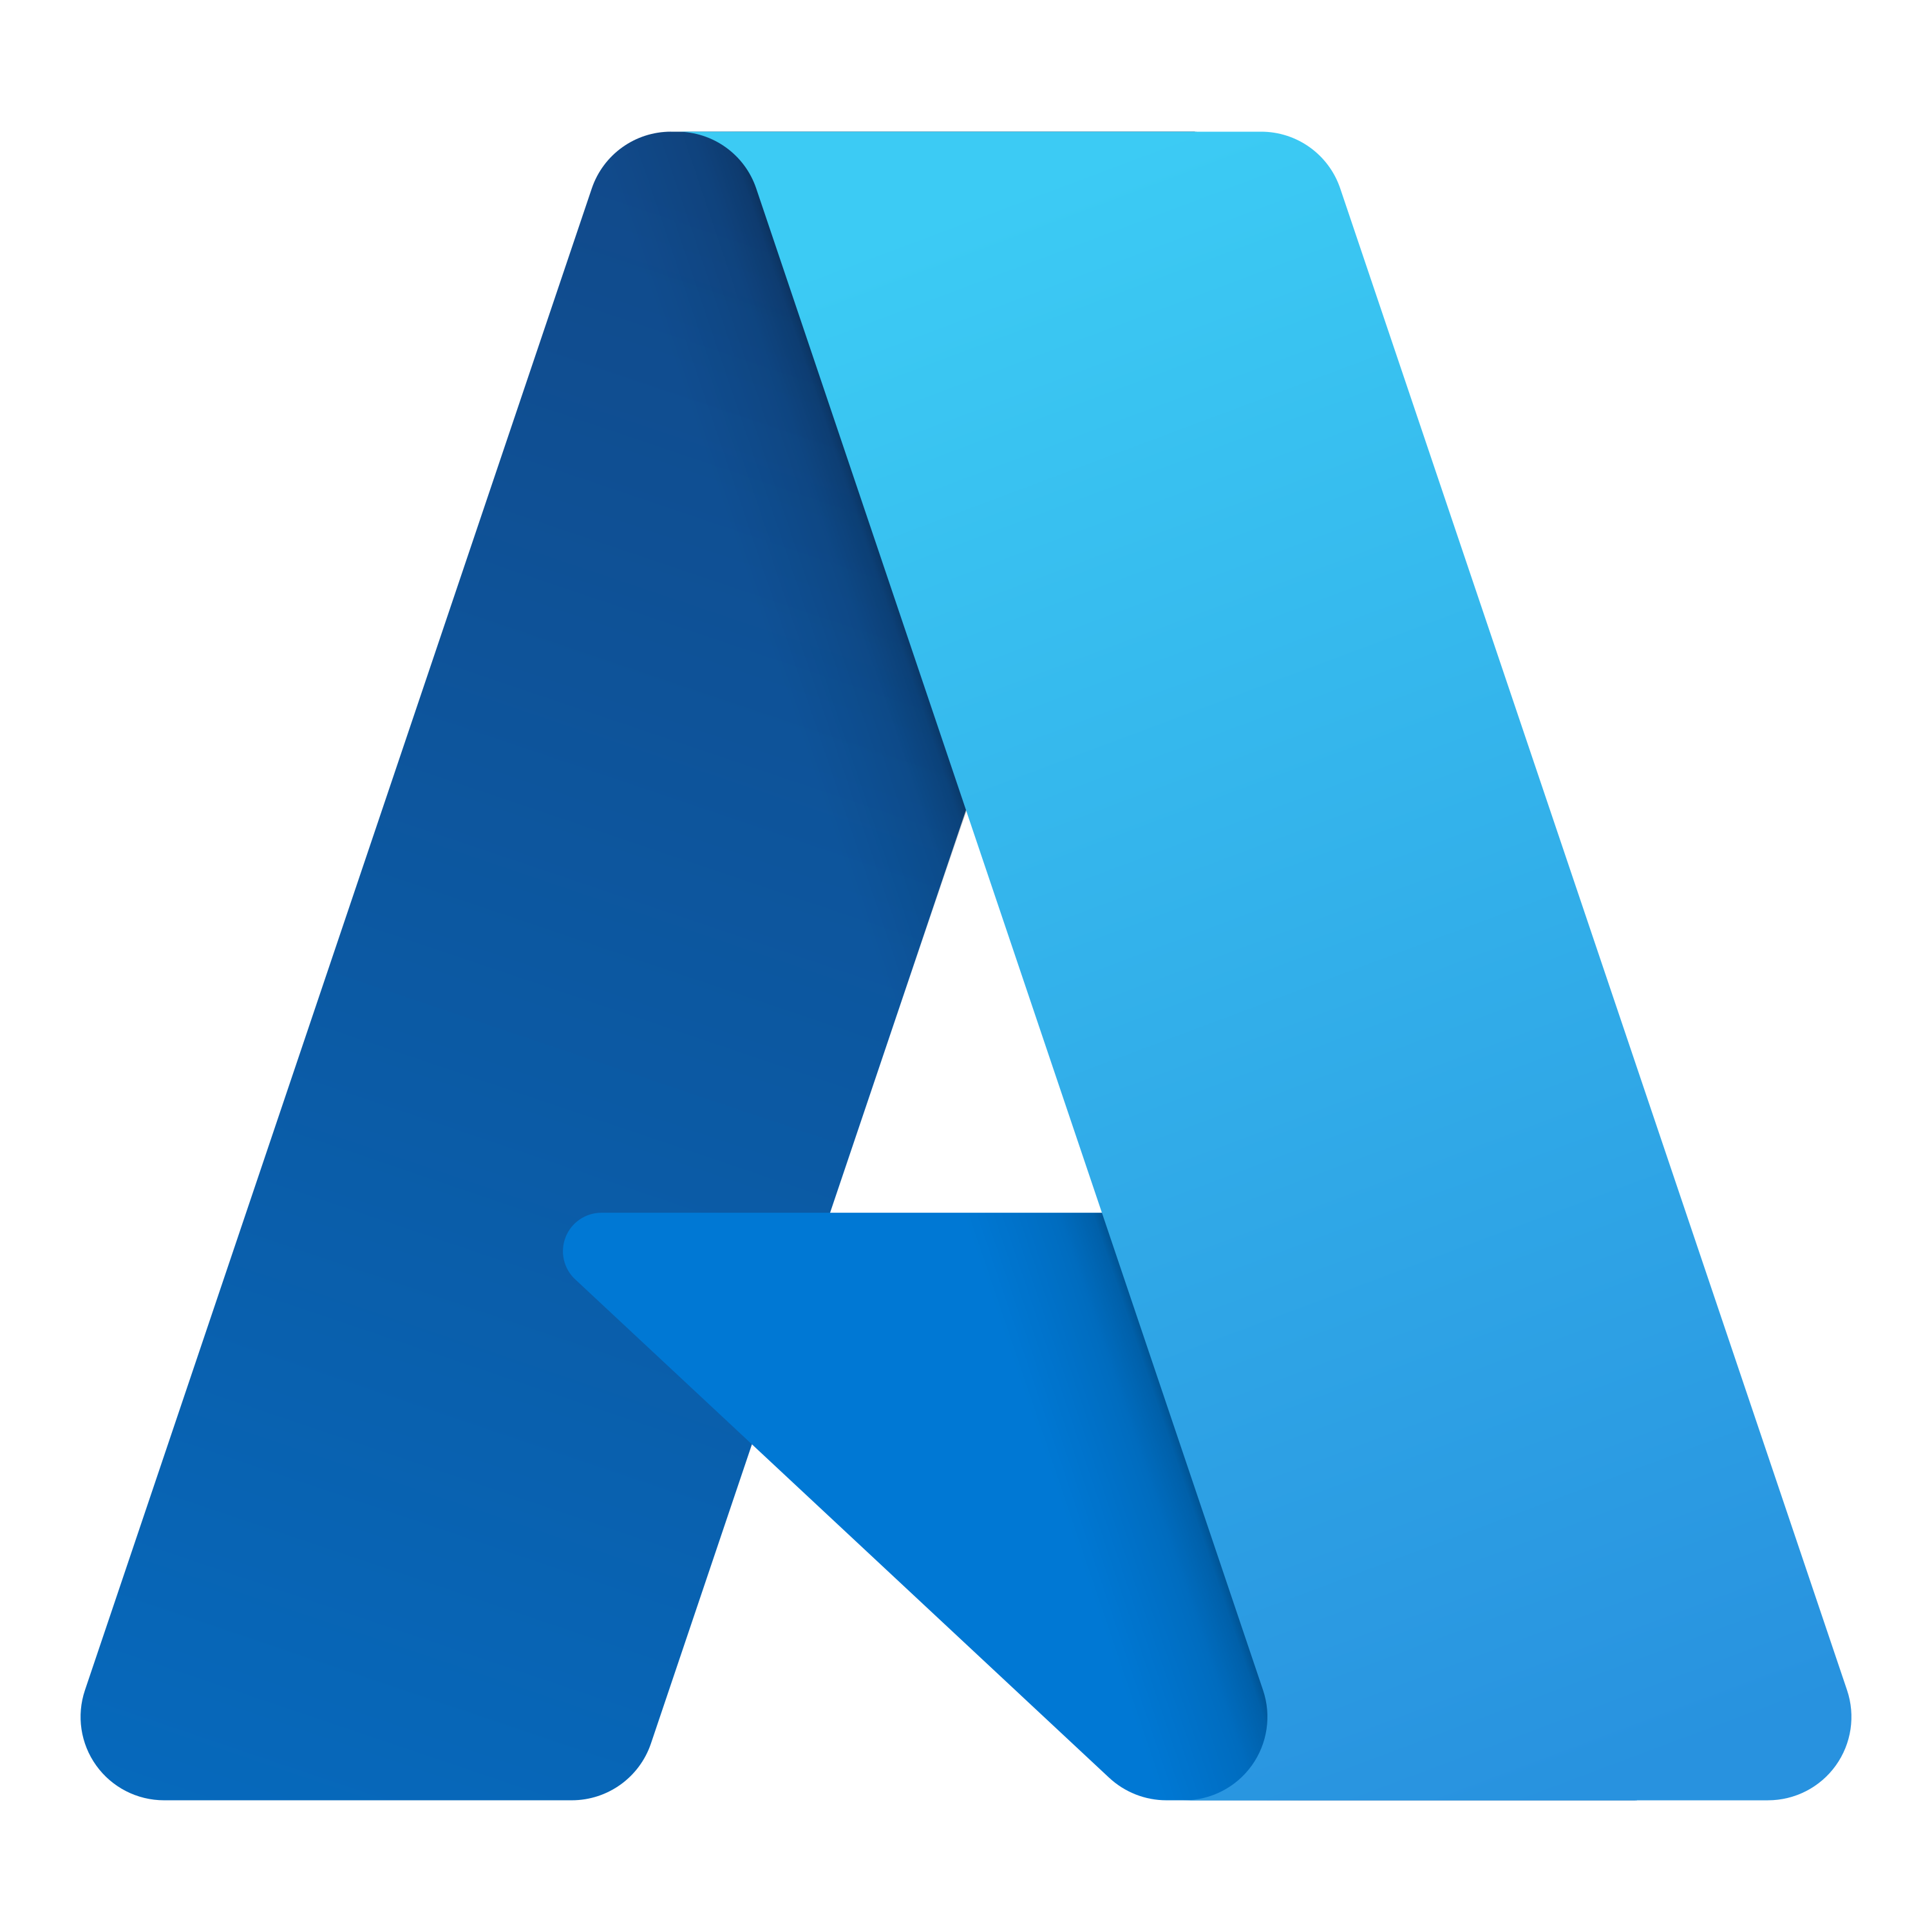
Prepare the environment
Install Docker Desktop
Install Visual Studio 2022 (or 2019)
Azure account: you should be able to create Azure Services
Use the Bash environment in Azure Cloud Shell.
Install the Microsoft Azure Service Fabric SDK
Notes:
Let’s prepare our environement for running containers locally
We need to install Docker Desktop it is free
This week, 8 November, Microsoft made generally available to users worldwide its latest versions of Visual Studio and .NET.
Users can download Visual Studio 2022 and .NET 6.
We will use in this session the latest version of Visual Studio.
We need an azure account to be able to create an azure container registry.

Slide 9
Create a web app with Azure command-line interface (CLI)
# generate a unique name and store as a shell variable
webappname=mywebapp$RANDOM
# create a resource group
az group create --location canadacenter --name myResourceGroup
# create an App Service plan
az appservice plan create --name $webappname --resource-group myResourceGroup --sku FREE
# create a Web App
az webapp create --name $webappname `
--resource-group myResourceGroup `
--plan $webappname
Notes:
Generate a random web app name.
Create a resource group.
Create a new App Service plan using the randomly generated web app name as the name of the plan and the FREE tier.
Create a new web app using the App Service plan created earlier and the randomly generated name.

Slide 10
Deploy a web app with Azure CLI
# store a repository url as a shell variable
gitrepo=https://github.com/didourebai/MCTWestAfrica # deploy code from a Git repository
az webapp deployment source config --name $webappname --resource-group myResourceGroup --repo-url $gitrepo --branch master --manual-integration
# print out the FQDN for the Web App
echo http://$webappname.azurewebsites.net
Notes:
Store a GitHub URL (URL for a publicly available Git repo).
Deploy code from the public URL by using the master branch to the web app created earlier.
Print out the fully qualified domain name (FQDN) by using string concatenation and the web app name variable.

Slide 11
Demo: Create Azure App Service Web Apps

Slide 12
Azure Container Registry

Slide 13
Build and store images by using Azure Container Registry
What is Container Registry?
Azure service that you can use to create your own private Docker registries.
Similar to Docker Hub but offers a few unique benefits: Container Registry runs in Azure, Container Registry is highly scalable, providing enhanced throughput for Docker pulls that can span many nodes concurrently.
Use Container Registry
Create a registry by using either the Azure portal or the Azure CLI.
Store and host images, and build images.

Slide 14
Demo: Create an ACR with Azure Portal

Slide 15
Create an ACR with Azure CLI
az acr create --resource-group mctwestrg --name acrdemoapp --sku Basic --admin-enabled true
Notes:
Store a GitHub URL (URL for a publicly available Git repo).
Deploy code from the public URL by using the master branch to the web app created earlier.
Print out the fully qualified domain name (FQDN) by using string concatenation and the web app name variable.

Slide 16
Azure Kubernetes Services

Slide 17
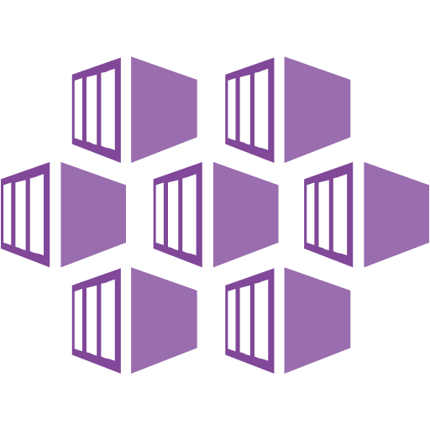
Azure Kubernetes Services
Azure Kubernetes Service (AKS) is a managed Kubernetes service that lets you quickly deploy and manage clusters.
Notes:
Azure Kubernetes Service (AKS) simplifies deploying a managed Kubernetes cluster in Azure by offloading the operational overhead to Azure. As a hosted Kubernetes service, Azure handles critical tasks, like health monitoring and maintenance. Since Kubernetes masters are managed by Azure, you only manage and maintain the agent nodes. Thus, AKS is free; you only pay for the agent nodes within your clusters, not for the masters.

Slide 18
Create AKS cluster using Azure CLI
az aks create --resource-group aksgr --name myAKSCluster --node-count 1 -- generate-ssh-keys --attach-acr aksprojectcontainer
Notes:
Create an AKS cluster using the az aks create command. The following example creates a cluster named myAKSCluster with one node:

Slide 19
Demo: Create and deploy Kubernetes application

Slide 20
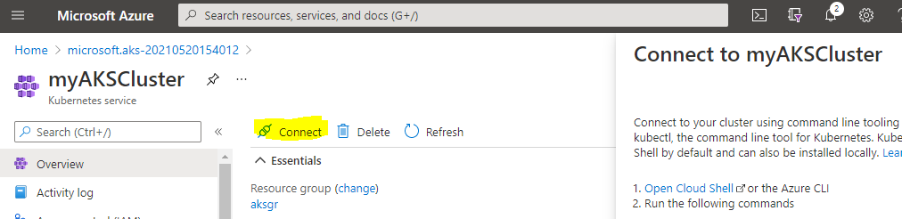
Deploy an Azure Kubernetes Service cluster and run an application using the Azure CLI
1- Open CloudShell My Dashboard — Microsoft Azure and connect to your cluster as bellow:
az account set — subscription yoursubscription
az aks get-credentials — resource-group aksgr — name myAKSCluster
You can find these commands when you open Azure Portal and your cluster:

Slide 21
Deploy an Azure Kubernetes Service cluster and run an application using the Azure CLI
2- Create an empty file called: azure-demo-deployment.yaml
3- Copy this content to the empty file created, we will describe it after.

Slide 22
Deploy an Azure Kubernetes Service cluster and run an application using the Azure CLI
apiVersion: apps/v1
kind: Deployment
metadata:
name: demo-kubernetes-deployment
spec:
selector:
matchLabels:
app: demo-kubernetes-pod
replicas: 1
template:
metadata:
labels:
app: demo-kubernetes-pod
spec:
containers:
-- name: aksprojectcontainer
image: aksprojectcontainer.azurecr.io/aksproject:latest
ports:
-- containerPort: 80

Slide 23
Deploy an Azure Kubernetes Service cluster and run an application using the Azure CLI
4- Run the application and deploy it in the cluster using the kubectl apply command and specify the name of your YAML manifest.
kubectl apply -f azure-demo-deployment.yaml
We will use kubectl get deployments to verify if the deployment was created or not.
When the application runs, a Kubernetes service exposes the application front end to the internet. This process can take a few minutes to complete.
5- we will use kubectl get service command with the --watch argument.
kubectl get service demo-kubernetes-deployment — watch

Slide 24
Service Fabric

Slide 25



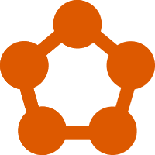
Service Fabric overview
Service Fabric is a large-scale microservices execution platform
Azure Service Fabric is a Microsoft PaaS
Service Fabric is a distributed systems platform
Service Fabric is not only an Orchestrator for Container
Service Fabric can be deployed on Azure or AWS or OpenStack
Notes:
Service Fabric allows you to create and manage scalable and reliable applications, composed of microservices. These distributed microservices run at very high density on a shared pool of virtual machines, which corresponds to a cluster. Service Fabric represents the next generation platform for building and managing these cloud-level, tier 1 enterprise applications running in containers and works with other providers such as AWS and OpenStack.

Slide 26
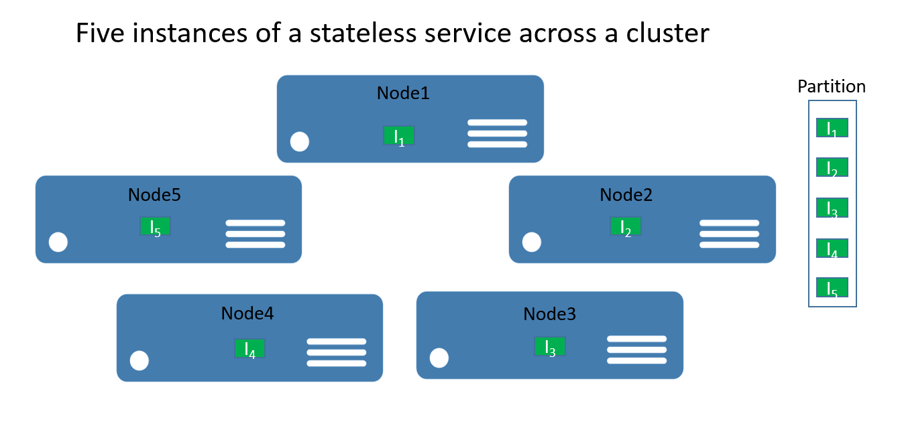
Service Fabric Cluster structure
Service Fabric cluster: a network-connected set of virtual machines (VMs) into which your microservices are deployed and managed.
The nodes are the VMs that belong to the Service Fabric cluster.
Notes:
We will see how we can create a local service fabric cluster using SDK service, this cluster will allow us to create service fabric application using Visual Studio and deploy it locally after we will deploy on Service Fabric cluster in Microsfot Azure.
Service Fabric cluster: a network-connected set of virtual machines (VMs) into which your microservices are deployed and managed.
A cluster is a set of nodes that are VMs, node numbers depends from the use of clusters, in development phase, one node is used but in production, you need to have more than 5.
Every node has an operating system windows or linux with a runtime. A node can host multiples applications it depend from the resource available in the virtual machine.

Slide 27
Demo: Create and Deploy a Service Fabric application to a cluster in Azure

Slide 28
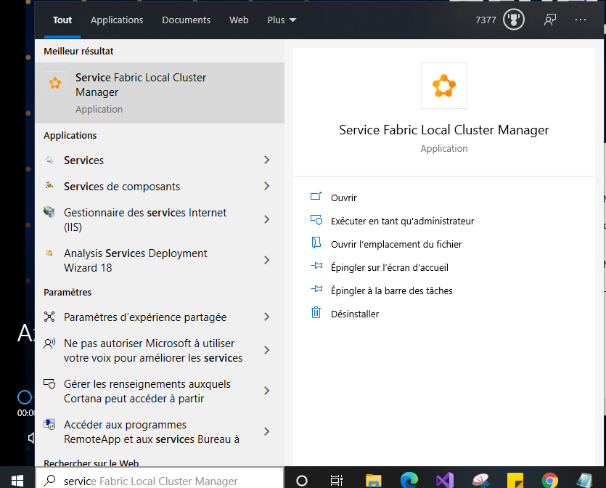
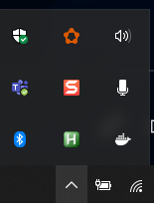
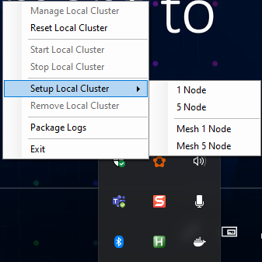
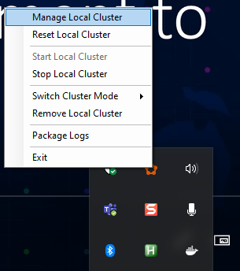
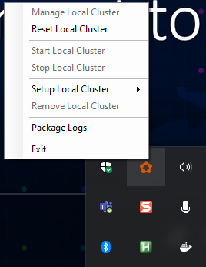

Slide 29

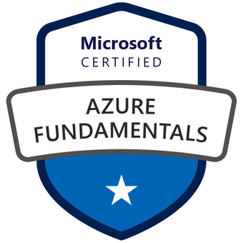

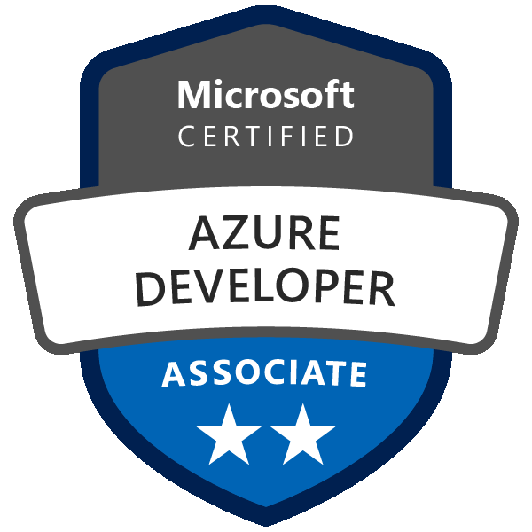
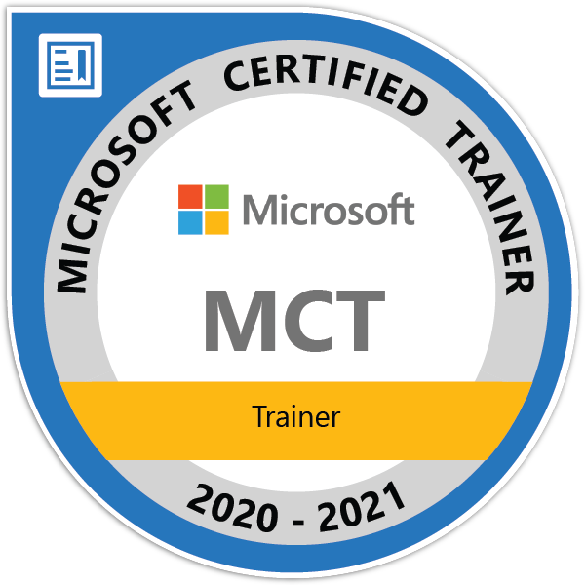

Questions
Twitter: @rebaihamida
didourebai@gmail.com
https://www.linkedin.com/in/hamida-rebai-trabelsi-09b8525/

